Slide 1
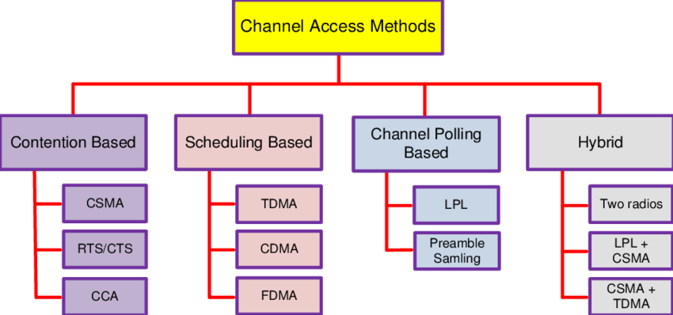

Slide 2
Contention Based MAC Protocols
With the contention-based Carrier Sense Multiple Access (CSMA) method, a transmitting node competes with its neighbors to acquire the channel.
Before any transmission, it first senses the carrier.
If the carrier is found idle, it starts with its transmission, otherwise defers the transmission for some random time
Such MAC protocols consume less processing resources and are suitable for event-driven WSN applications.
They are flexible to network scale and dynamics as no clustering and topology information is required.
However with this approach, the transmission is purely handled by the sender and the problem of hidden- and exposed-terminal may occur resulting in collisions, overhearing, idle listening, and less throughput.

Slide 3
(RTS/CTS)
The Request To Send and Clear To Send (RTS/CTS) handshake is among the several approaches which have been proposed in order to minimize the hidden- and exposed-terminal problem in CSMA.
The RTS/CTS handshake is initially performed between the sender and the receiver and then the actual data packet is sent.
Unfortunately, this method is not fully able to eliminate the hidden-terminal problem and moreover, it incurs additional overhead in transmitting control packets.

Slide 4
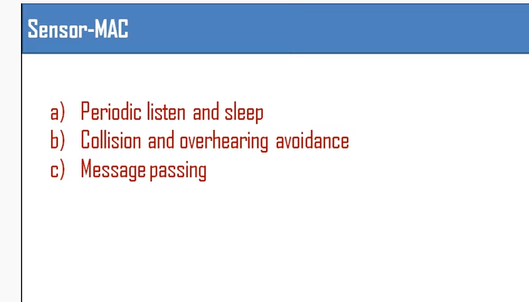

Slide 5
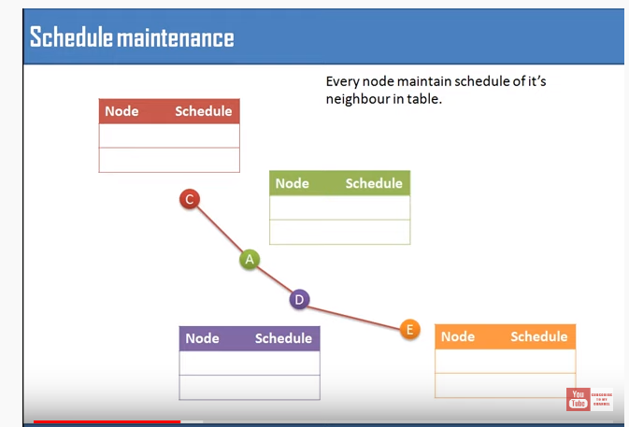

Slide 6
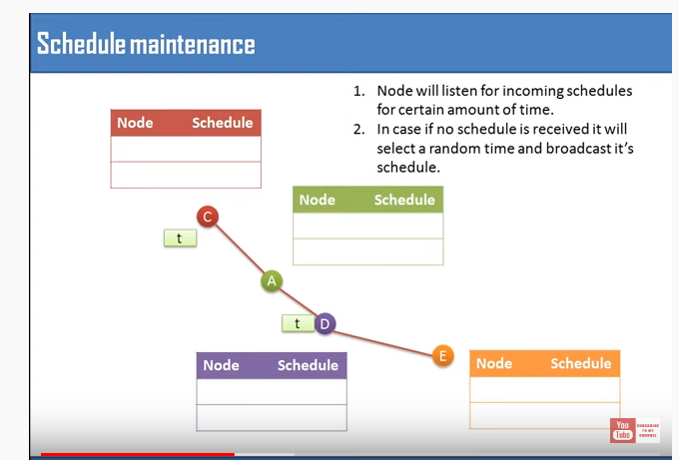

Slide 7
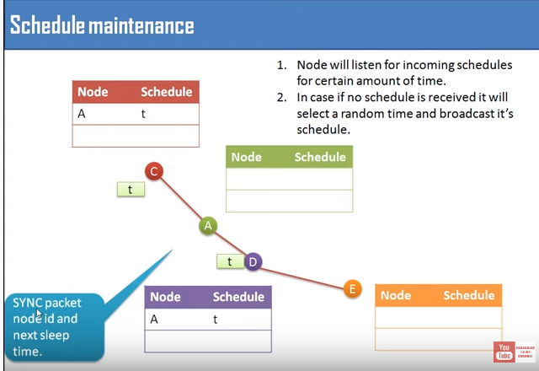

Slide 8
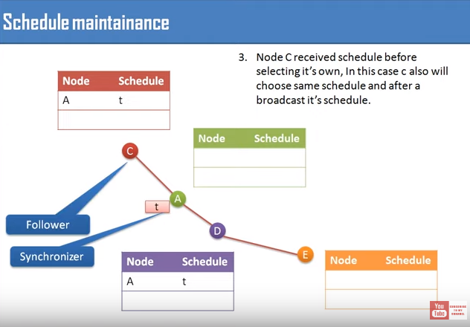

Slide 9
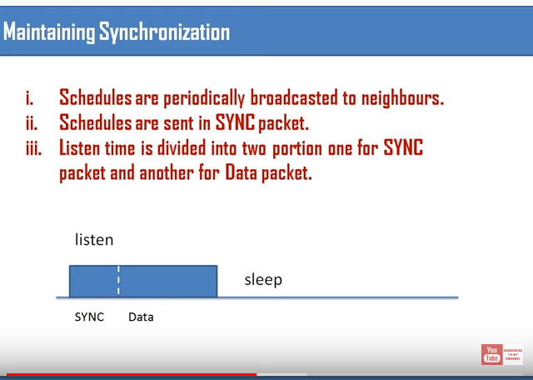

Slide 10
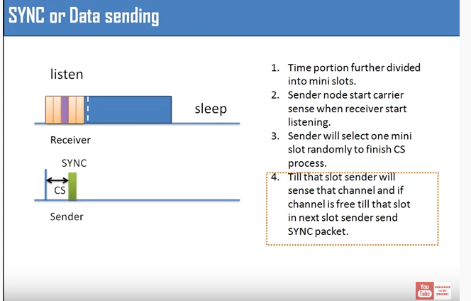

Slide 11
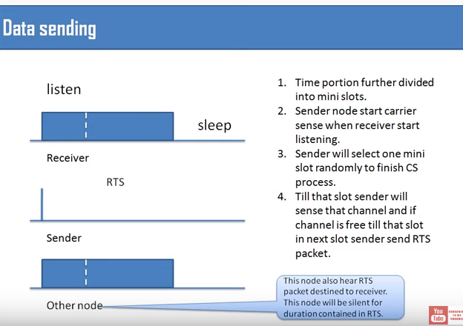

Slide 12
S-MAC
The design of the Sensor-MAC (S-MAC) was one of the first attempts to significantly reduce idle listening, collisions, and overhearing in WSNs by putting nodes in listen and sleep periods.
Listen periods are normally of fixed size according to some PHY and MAC layer parameters
The length of sleep periods depends on a predefined application based duty cycle parameter.
SMAC attempts to coordinate the schedules of neighboring nodes by letting nodes share common listen periods according to a schedule.
This requires formation and maintenance of synchronization
among nodes.
In order to reduce the hidden-terminal effect, S-MAC uses the RTS/CTS handshake scheme for unicast messages.

Slide 13
S- MAC( Sensor-MAC)
It is divided into two parts, a listening session and a sleep session.
The listening session enables sensor nodes to communicate with other nodes to exchange some control packets.
During the sleep session, the nodes turn their radio off to save energy . The first part of the listening session is the synchronisation by sending SYNC packets.
Every node maintains a schedule table which stores all the schedules (listen and sleep sessions) of all its known neighbours.
During the synchronisation, a node broadcasts its schedule to all its neighbours .
After that, every node has a schedule of its neighbours and can use this to send data to the neighbours.
Before a node wants to send data to its neighbour to arrange a data exchange, it knows the neighbour schedule, sends an RTS packet and waits for neighbour’s answer.
If the neighbour is ready to receive it sends a CTS packet and the data transmission can start immediately .
Nodes which are not participating in any data transmission change to sleep mode to save energy.

Slide 14
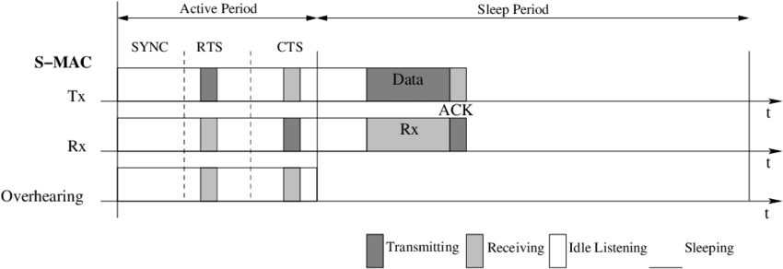

Slide 15
The listen period is further divided into two sub parts; the SYNC period and the Data period.
During the SYNC period, a node accepts SYNC packet from its neighbors, stores in its schedule table, and adapts it.
The data period is used to exchange data related messages which may include RTS, CTS, DATA, or ACK messages.
To minimize costly retransmissions, S-MAC fragments long messages into short frames and sent them in a burst.

Slide 16
Using synchronisation (SYNC) packet, every node now has the schedule of its neighbour and can arrange a data transfer.
This enables the usage of this protocol in a multihop network .
It is required that every node maintains its scheduling table after a certain number of scheduled synchronisations.
Therefore, every node should listen for a full period to find the neighbours who may have different time schedules. This causes packet overhead and is the disadvantage of this protocol.

Slide 17
S-MAC is rigid and optimized for a predefined set of workloads as there is no mean to adapt the length of listen and sleep periods with changing traffic conditions.
The formation, maintenance, and compliance of synchronization has serious consequences in WSNs.
Longer and fixed sleep periods of S-MAC have serious impact on system latency.
It could be worsen if intermediate nodes on a route do not share a common schedule.
To decrease latency, an adaptive listening mechanism is employed with S-MAC.

Slide 18
T-MAC
The Time-out MAC (T-MAC) protocol improves the energy efficiency of S-MAC specially under
variable traffic conditions by adaptively shorten the listen period.
The listen period ends when no activation event has occurred for a threshold period TA unlike S-MAC where the listen period is always rigid one.
This aspect frees the application from selecting an appropriate duty cycle value.
The comparison between S-MAC and T-MAC shown in Figure below confirms this improvement.
Although T-MAC has better results under variable loads, the synchronization of the listen periods within virtual clusters may partially break down.
This could result in the early sleep problem for T-MAC. The early sleep happens when a node, goes to sleep mode when a neighbor still has messages for it.
However with T-MAC, Future Request To Send (FRTS) frames can be sent to the third hop nodes either to extend their TA expiration or to let them awake by the
appropriate time.
T-MAC saves more power than S-MAC and minimizes collisions and redundancy as nodes switch back to sleep mode if no activity is found for a TA time.
But this comes at the cost of reduced throughput and higher latency. T-MAC also suffers from synchronization and scaling problems.

Slide 19
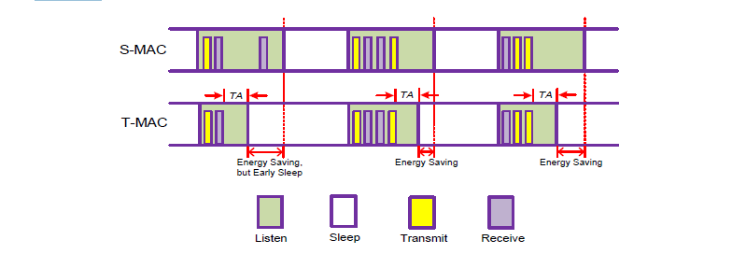

Slide 20
DSMAC
The Dynamic S-MAC (DSMAC) improves latency of S-MAC by dynamically adjusting the duty cycle value of nodes as per traffic and energy conditions.
All nodes start with the same duty cycle value and share their one-hop latency values in the SYNC period.
When a node notices that the traffic has been increased or low latency is required, it adds extra active periods, shortens its sleep time, and sends an updated SYNC message to its neighbors.
On receiving the updated SYNC message, a neighboring node checks its queue for packets destined to that node.
If there is a one, it doubles its duty cycle provided that its battery level is above a specified threshold.
The latency observed with DSMAC is better than S-MAC, but it uses less frame duration, and thus achieves less throughput at high traffic.
The complexity in adapting the duty cycle value especially within a virtual cluster and under high traffic loads manifolds the already existing synchronization overhead.

Slide 21
Scheduling Based MAC Protocols
Scheduling based schemes assign collision-free links to each node in the neighborhood usually during the initialization phase.
Links may be assigned as time slots (TDMA), frequency bands (FDMA), or spread spectrum codes (CDMA).
However, due to the complexities incurred with FDMA and CDMA schemes, TDMA schemes are preferred as scheduling methods for WSNs.
With TDMA schemes, the system time is divided into slots and each one is allocated to a node in the neighborhood.
A schedule in such schemes regulates which participant may use which resource at what time.
The schedule can be fixed or computed on demand (or a hybrid) and is typically regulated by a central authority.
A node can only access its allocated time slot and does not need any contention with its neighbors.

Slide 22
The cardinal advantages of scheduling based schemes include minimum collisions, less overhearing, and implicitly avoidance of idle listening.
They also provide a bounded and predictable end-to end delay.
However, the average queuing delay is much higher as a node has to wait for its allocated slot before accessing the channel.
Overhead and extra traffic required in setting up and maintaining synchronization among nodes, no mean to adapt with varying traffic and topology conditions, reduced scalability, and low throughput are the major concerns with these schemes.
Allocating conflict-free TDMA schedules is indeed a difficult task in itself.
A peer-to-peer based communication is usually not possible as nodes are normally allowed to communicate only with the central authority.

Slide 23
LEACH
A mostly scheduled based Low-Energy Adaptive Clustering Hierarchy (LEACH) protocol divides a dense and homogeneous WSN into clusters each supervised by a cluster head.
The cluster head is responsible for creating and maintaining TDMA schedules, communicating with its cluster members, and forwarding the received messages to the sink node.
As the cluster head is always switched on, therefore the chances of a cluster head to die earlier are high.
However, LEACH uses a randomized rotation mechanism for selecting a cluster head.
Each node can independently decide to become a cluster head with preference is given to the node who has not been cluster head for a long time.
Thus LEACH tries to distribute the energy among nodes in an evenly manner.

Slide 24
LEACH works in rounds and each round is divided into set-up and steady-state phases.
The cluster formation occurs during the set-up phase where each cluster head broadcasts an advertisement message (ADV) using CSMA to invite its members.
The cluster head then creates and broadcasts a TDMA schedule for nodes that have sent join-request (REQ) to it.
In order to reduce intercluster interference, the cluster head chooses a random CDMA code for its members.
Once the set-up phase is completed, the steady-state phase starts where a node can transmit data to its head by using its allocated slot.
Upon receiving packets from its members, the cluster head aggregates and sends them to the sink node. The cluster head directly communicates with the sink using CSMA as LEACH does not allow any inter-cluster communication.

Slide 25
A cluster head has to perform highly computational and energy consuming tasks.
It prepares and maintains the TDMA schedule, remains awake for the whole round, aggregates data, and transmits
it directly to the sink node.
LEACH guarantees that each member node belongs to at most one cluster.
However, due to an ADV collision, it can not guarantee that each member node belongs to a cluster.
In that case, LEACH considers that all nodes are within the range of the sink node.
The lack of such multi-hop communication capabilities severely limit the network scalability.
The channel under-utilization occurs with LEACH as it considers that nodes always have data to send during their allotted time. Perfect correlation is assumed, which is hardly possible in WSNs.

Slide 26
TRAMA
The TRaffic-Adaptive Medium Access (TRAMA) protocol is mostly a TDMA based protocol that creates schedules for time-synchronized nodes on a distributive manner based on traffic information.
The system time is divided into cycles, each containing a random access and a scheduled access periods.
The random access period consists of a collection of signaling slots, whereas the scheduled access period contains collection of data transmission slots.

Slide 27
TRAMA consists of three components: a Neighbor Protocol (NP), a Schedule Exchange Protocol (SEP), and an Adaptive Election Algorithm (AEA).
NP works during the random access period and is used to exchange one-hop neighbor information and to gather two-hop topology information for each node in the network.
During SEP, a node transmits its current transmission schedule and also picks up schedules of its neighbors.
To win a time slot, a node computes its own priority and the priority of all its two-hop neighbors for each time slot.
AEA also works during the scheduled access and uses neighborhood schedule information to select the transmitters and receivers for the current time slot, letting all other nodes to switch to low-power sleep mode.
For an efficient channel utilization, AEA uses traffic based information that is exchanged among nodes during SEP and attempts to reuse slots that are not used by the selected transmitter.

Slide 28
A node using TRAMA can have one of the three states: transmit, receive, and sleep.
The state of a node is determined based on its two-hop neighborhood information and the schedules announced by its one-hop neighbors.
A node is in transmit state if it has data to send with the highest priority among its contending set.
If not, the node will consult the schedule sent by the current transmitter.
If the transmitter have traffic destined for this node in the current slot, it will stay in receive mode otherwise can go to sleep mode.

Slide 29
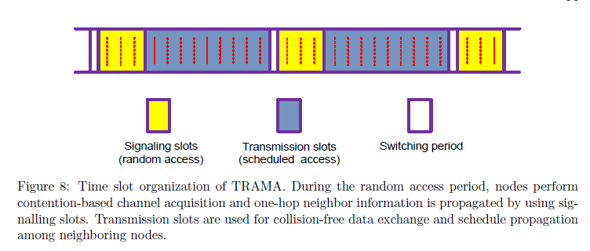

Slide 30
Reuse of time slots, utilizing neighborhood and traffic information, and hybrid scheme are the positive features of TRAMA.
The protocol also shows higher percentage of sleep time, less collision probability, and better data delivery with TRAMA as compared to S-MAC
However, all nodes in TRAMA are defined to be either in receive or transmit states during the random access period for exchanging schedules.
And for each time slot, every node calculates priorities for its own as well as for its two-hop neighbors. This results in significant computation, large queuing delays, and ineffective channel and memory utilization, since the hop neighborhood in a dense WSN could be large enough.
Therefore, TRAMA is usually practicable for networks having sufficient resources but are less delay sensitive.

Slide 31
Channel Polling Based MAC Protocols
With the channel polling scheme, also known as preamble sampling or Low Power Listening (LPL), a sending node prefixes data packets with extra bytes called a preamble and sends it over the channel to ensure that the destination node detects radio activity and wakes up before the actual payload is sent.
On a wake-up, if radio activity is detected, the receiver turns on its radio to receive data packets. Otherwise, the node goes back to sleep mode until the next polling interval.
To avoid deafness, a sender prefixes preamble at least as long as the check interval of the receiver to ensure that the receiver wakes up and performs channel sampling at least once while the preamble is being sent. Figure below shows an example how channel polling works in WSNs.

Slide 32
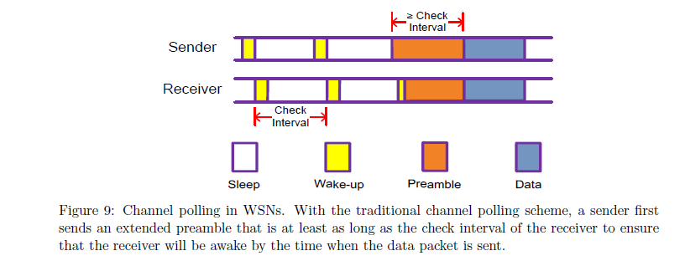

Slide 33
Channel polling protocols do not use common active/sleep schedules, and therefore do not need any synchronization or clustering. Receivers consume significantly less energy as they wake up for very short period of time but senders pay the price in sending long and extended preambles.
For high traffic load this could lead to very costly collisions.
Another issue with channel polling is the limitation of the duty cycle value. Lowering the duty cycle extends the check interval. That is good from the receiver point of view but it significantly increases the transmission cost in the shape of long and extended preambles at the sender side.
Such extended and long preambles also result in unnecessary energy consumption both at the receiver and sender ends, overhearing at non-target receivers, and excessive latency at each hop.
These issues can be tackled by using short preambles, adaptive duty cycle values, and minimizing redundancy.
Another issue with this scheme is related to the support of radio chip in sending an extended preamble prior to the data packet.

Slide 34
B-MAC
Berkeley MAC (B-MAC) protocol is one of the initial MAC protocols working on the channel polling mechanism, where each node can have independent awake and sleep periods.
The sum of both these periods is called check interval.
While transmitting, a node precedes the data packet with a preamble that is slightly longer than the check interval of the receiver.
Nodes wake up at each awake period and sample the medium shortly.
If it detects a preamble, it remains awake to receive the whole preamble.
If the preamble is destined to this node, it further extends its wake-up time to receive the data packet; otherwise goes back to sleep mode.
With the extended preamble, a sender is assured that at some point during the preamble sending, the receiver will wake up and detect the preamble.

Slide 35
B-MAC uses Clear Channel Assessment (CCA) to determine whether the channel is clear.
Instead of using a threshold, which is the common method for many CSMA protocols, B-MAC improves the quality of CCA by using an outlier detection method.
When a node wants to transmit, it takes a sample of the channel and searches for outliers.
If an outlier is detected, B-MAC declares the channel is clear because a valid packet could never have an outlier significantly below the noise floor.
Alternatively, if no outlier is found for five samples, B-MAC declares the channel is busy.

Slide 36
With an extended preamble, B-MAC reduces duty cycle and minimizes idle listening, especially when there are no packet exchanges.
During transmissions a preamble sent by the sender needs to be longer than the check interval of receivers. As a result, the overhead of preambles increases as the check interval increases.
Such extended preambles also introduce excessive latency at each hop and increases energy consumption not only for the transmitter and the intended receiver, but also for non-targeted receivers once they overhear these long preambles.
Only after receiving a full preamble, a node can know whether it is the actual node the packet is destined for.

Slide 37
WiseMAC
The WiseMAC is the first protocol working on non-persistent CSMA (np-CSMA) with the channel polling mechanism.
The basic functionality of WiseMAC is more or less similar to BMAC.
However, WiseMAC lets a node learn about the awake periods of its neighbors.
A sending node sends a preamble just before the receiving node wakes up and hence keeps the preamble length at minimum. The receiver puts the time of its next awake period in the ACK frame.
If a node finds the medium busy during the channel sampling, it continues to listen the medium until it receives a data packet or the medium becomes idle again.

Slide 38
All nodes in a network sample the medium with a common basic cycle duration, but their awake and sleep periods are independent and left unsynchronized.
WiseMAC uses short preambles for regular traffic and switches to longer preambles for infrequent communication.
For very low traffic loads where the data packet can be smaller than the preamble, WiseMAC repeats the data frame instead of the extended preamble.
With WiseMAC, over-emitting can occur if the receiver is not ready at the end of the preamble due to factors such as interference or collision.
This over-emitting can increase further with the increase in the preamble and data packet size.

Slide 39
Hybrid MAC Protocols
Hybrid MAC protocols combine the strength of two or more different MAC schemes in order to achieve a joint improvement.
They usually combine a synchronized protocol with an asynchronous one.
Though such protocols aggregate the advantages of two or more schemes, they also carry, among other, scaling and increased complexity problems, since they have to maintain two or more different working modes.

Slide 40
IEEE 802.15.4
Wireless Sensor Network(WSN) is resource constrained network developed specially targeting applications having unattended network for long time.
Such a network requires energy efficient and energy aware MAC and Physical layer.
The previously proposed standards like IEEE 802.11 , IEEE 802.16 or IEEE 802.15.1 do not consider the node energy in their design. That makes them inappropriate for WSN and need for new protocol standard.

Slide 41
IEEE 802.15.4 is one of such standards specially developed for low rate, low power networks like WSN.
IEEE 802.15.4 is designed considering the energy concerns of sensor nodes.
For efficient energy utilization, standard uses various improved techniques like, low-power transmission, small frame size, energy-efficient carrier sense multiple access with collision avoidance (CSMA-CA) algorithm and mechanism to support inactive period.

Slide 42
As per the specification IEEE 802.15.4 comes with following features:
868 - 868.6 MHz (e.g., Europe)
902 - 928 MHz (e.g., North America)
2400 - 2483.5 MHz (worldwide)
3100 - 10 600 MHz (UWB varies by region)
Over the air data rates of 851 kb/s, 250 kb/s, 110 kb/s, 100 kb/s, 40 kb/s, and 20 kb/s
Star or peer-to-peer operation
Allocated 16-bit short or 64-bit extended addresses
Optional allocation of guaranteed time slots (GTSs)
Carrier sense multiple access with collision avoidance (CSMA-CA) channel access
Fully acknowledged protocol for transfer reliability
Low power consumption and Energy detection (ED)

Slide 43
The standard specifies bottom two layers of network protocol stack, MAC layer and physical layer.

Slide 44
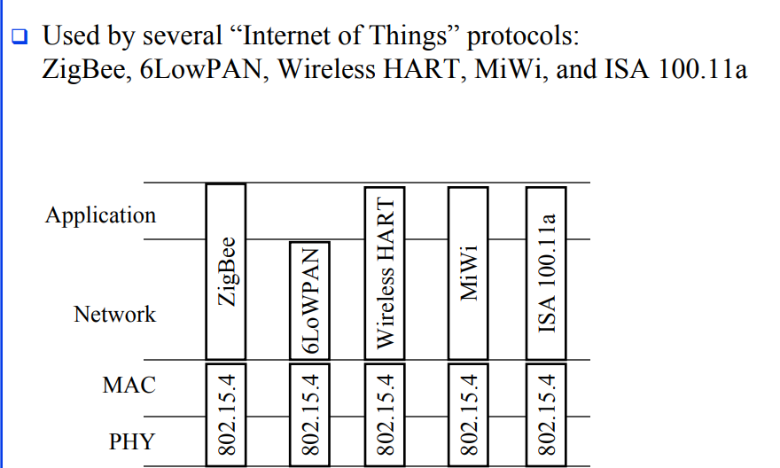

Slide 45
It divides network nodes into three groups, personal area coordinator (PAN coordinator), coordinator nodes and device nodes.

Slide 46
An IEEE 802.15.4 network is composed of nodes that take different roles during the operational phase of the system.
Full Function Devices (FFD), also called beacon enabled devices, can operate either as Personal Area Network Coordinators (PANc), Cluster Heads (CLH) or routers.
On the other hand, Reduced Function Devices (RFD) also called non beacon devices can only operate as end devices.
A network includes at least one FFD, operating as the PANc.
Other devices can either act as end devices forming a star around the coordinator, as routers creating a mesh network or as a combination of CLHs and end devices creating a cluster-tree topology.

Slide 47
PAN coordinator is responsible for creating and managing the network.
Network coordinators are responsible for node synchronization using beacons and providing the routing functionality to device nodes.
Lastly, device nodes are responsible for collecting the information in the network and forwarding it to network coordinators or PAN coordinator .
As per the standard PAN coordinator and coordinator nodes are categorized as Full Function Device (FFD) nodes while the device nodes may be categorized as Reduced Function Device (RFD) nodes or FFD.
FFD spends more time in active state and consumes more energy while RFD spends more time in sleep state and consumes less energy compared to FFD.

Slide 48
Two topologies are supported by 802.15.4 - star and peer-to-peer - with the logical structure of the latter being defined by the network layer.
Applications such as personal computer peripherals and WBANs would typically employ a one-hop star topology.
Peer-to-peer topology allows for more complex formations like the cluster-tree and mesh networking topologies and may be the preferred choice for applications such as industrial and environmental monitoring, inventory control, etc.

Slide 49
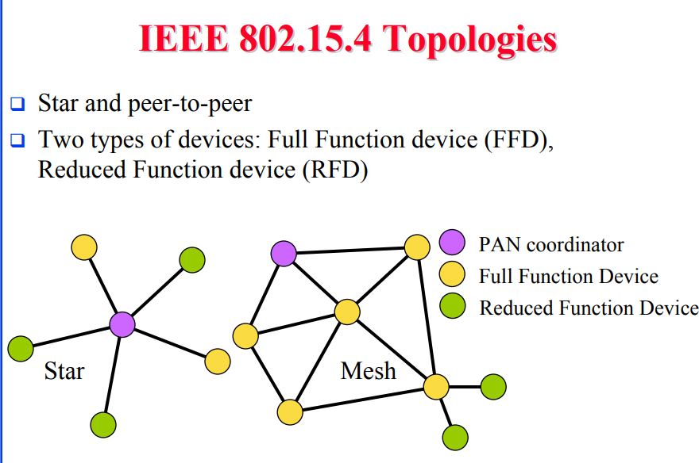

Slide 50
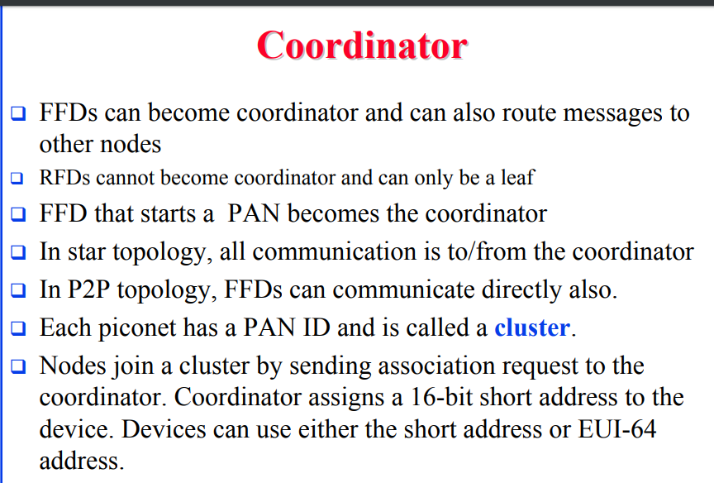

Slide 51
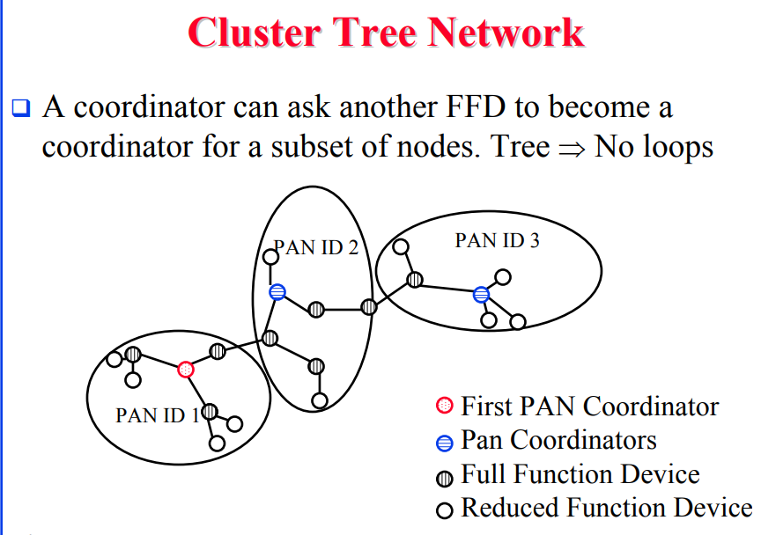

Slide 52
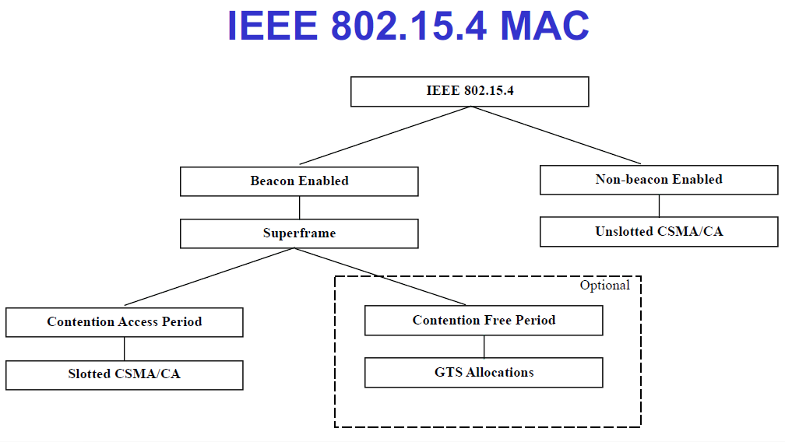

Slide 53
An 802.15.4 network can work either in beacon-enabled or in nonbeacon-enabled mode.
In the former mode, communication is controlled by a network coordinator, which transmits regular beacons for synchronization and association procedures.
In the nonbeacon-enabled mode, there are no regular beacons, but the coordinator may unicast beacons to a soliciting device.
Communication among devices in the nonbeacon-enabled mode uses unslotted CSMA for decentralized access.

Slide 54
A beacon frame is transmitted in the first slot of each superframe and is used to synchronize attached devices, to identify the PAN, and to describe the structure of the superframe.

Slide 55
The IEEE 802.15.4 MAC protocol specifies a beacon enabled and a beaconless mode of operation.
In the beaconless mode, devices communicate asynchronously, requiring nodes to be continuously in receive mode, awaiting reception of data transmissions from other devices.
Devices compete for channel access using an unslotted non-persistent CSMA/CA protocol.

Slide 56
In the beacon enabled mode, devices synchronize their actions and coordinate data transmission with each other.
FFDs periodically transmit beacon frames to synchronize wake up/sleep schedules with neighboring nodes.
Channel access and data transmission are carried out using a superframe structure.

Slide 57
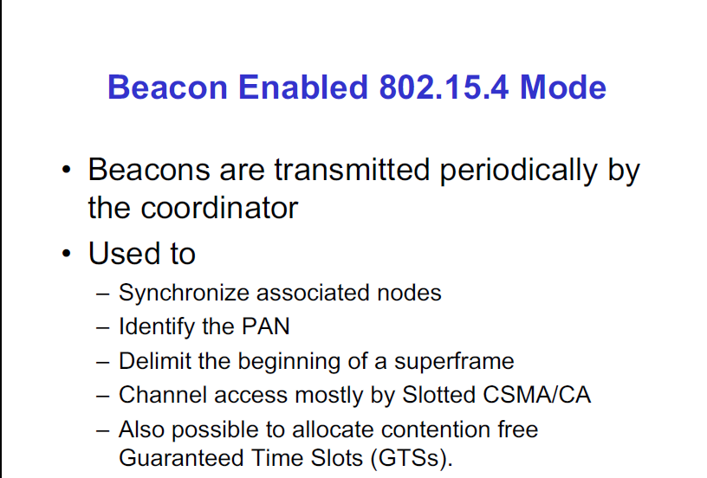

Slide 58
As shown in Figure below, the superframe is bounded by network beacons and is divided into 16 equally sized slots.
The first of which is dedicated to the transmission of the beacon frame.
The main purpose of the beacon is to synchronize devices in the network, to identify the PANc, and to describe the superframe structure.

Slide 59
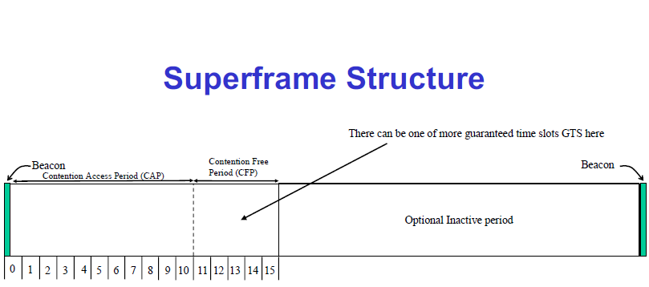

Slide 60
The format of the superframe is decided by the PANc and is constructed from the Beacon Interval (BI), which defines the time between two consecutive beacon frames, and the Superframe Duration (SD), which defines the nodes’ active period in the BI.
The superframe duration provides a contention access period (CAP) in which all devices use a slotted CSMA/CA protocol to gain access and compete for time slots,
This is followed by a contention free period (CFP) for low latency applications which is divided in guaranteed time slots (GTSs) to be allocated by the PANc.
In order to reduce energy consumption, the coordinator can introduce an inactive period by choosing BI > SD. The inactive period defines a time period during which all devices, coordinator included, go into a sleep mode.

Slide 61
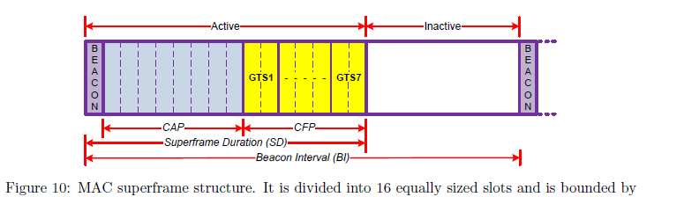

Slide 62
The superframe can be divided in two parts; Contention Access Period (CAP) and Contention Free Period (CFP).
Any device wishing to communicate during the CAP period competes with other devices using a slotted CSMA/CA mechanism.
For low-latency applications or applications requiring specific data bandwidth, the PAN coordinator may dedicate contention-free TDMA-like GTS portion of the CFP to devices.
The combination of CSMA and TDMA makes 802.15.4 MAC a hybrid protocol.

Slide 63
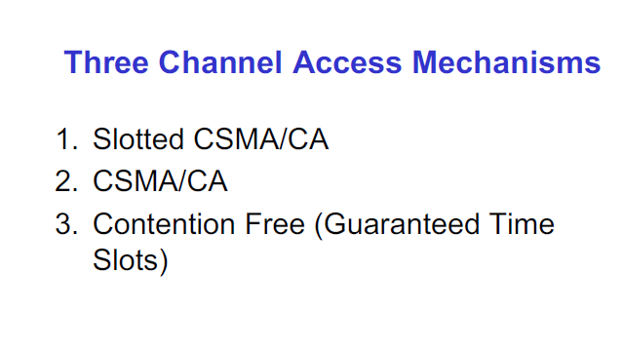

Slide 64
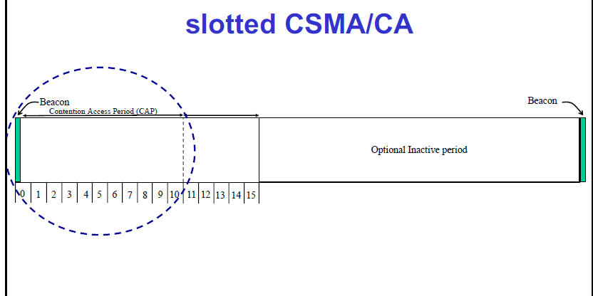

Slide 65
Non Beacon mode
The IEEE 802.15.4 does not give clear guidance on managing the resources in non-beacon mode and it is open for the final network design.
The ideal approach to maximize battery life is to turn the transceiver on only when it transmits and receives a frame.
Not knowing the exact times for frame transmission and reception, a certain amount of overhead is inevitable in a sensor network environment.
The major overhead of a receiving scheme is periodic idle listening for possible frame reception.
Here, wakeup interval and active duration determine consumption energy in non-beacon mode.
The former is how often and the latter is for how long the device wakes up.
The overhead for a transmitting scheme is mainly due to waiting time for a receiver’s wakeup schedule.

Slide 66
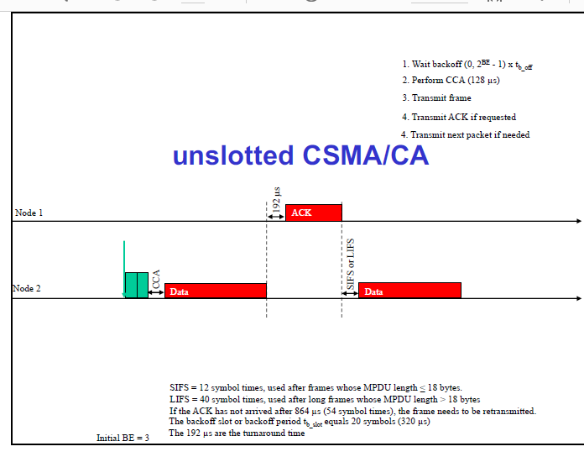

Slide 67
Issues with IEEE 802.15.4
IEEE 802.15.4 standard provides MAC and Physical layer specifications for energy efficient low power, low rate wireless networks, but there are points which remain untouched in the specification or specification does not give clear guidelines on them.

Slide 68
Beacon collision
IEEE 802.15.4 standard suggests two network topologies: star topology and peer-to peer topology. As nodes are equipped with low range radio modules, network needs to run in multi-hop mode.
Here, as per the standard, network should be organized as a hierarchical structure.
In this hierarchical structure, PAN coordinator works as root and at each level the coordinator node collects the information and forward it towards the PAN coordinator

Slide 69
With beacon enabled mode, coordinator nodes periodically broadcast their beacons.
As per the IEEE 802.15.4 specification to make the network synchronized these beacons are broadcasted without using CSMA-CA algorithm.
Due to this it may happen that these beacons collide with other packets in the network and get dropped.
If this beacon loss occurs due to other non beacon packet then network can recover from that.
But it may happen that two coordinators are within each others communication range and they broadcast the beacon which collide then it is hard to recover from such beacon loss.

